Slide 1
DAY 04
Model Application and API
Day focus
Save the trained pipeline for reuse
Student Performance Prediction Project
Load the model and test it with new student inputs
Create a reusable prediction function
Expose the prediction with a simple FastAPI endpoint
AI & Machine Learning Track
Bile Initiative

Slide 2
BILE Initiative · AI & Machine Learning Track
DAY 04
TABLE OF CONTENTS
01
From model to application
02
Save and load the trained pipeline
03
Predict on a new student record
04
Reusable prediction function
05
FastAPI structure
06
Example request and response
AI & Machine Learning Track

Slide 3
BILE Initiative · AI & Machine Learning Track
DAY 04
APPLICATION
From notebook to usable tool
A trained model becomes useful when other systems can call it reliably.
1
Understand
We save the pipeline so that preprocessing and prediction stay together.
2
Inspect
We then wrap the prediction logic in a simple API.
3
Prepare
This creates a clean bridge between machine learning and applications.
4
Use
AI & Machine Learning Track

Slide 4
BILE Initiative · AI & Machine Learning Track
DAY 04
SAVE MODEL
Save the trained model
import joblib
MODEL_PATH = "/content/student_risk_model.joblib"
joblib.dump(model, MODEL_PATH)
joblib stores the full trained pipeline in one file.
The saved file includes preprocessing and the classifier.
This lets us reuse the exact same model later.
AI & Machine Learning Track

Slide 5
BILE Initiative · AI & Machine Learning Track
DAY 04
LOAD MODEL
Load the model again
loaded_model = joblib.load(MODEL_PATH)
Loading the file restores the trained pipeline.
We do not retrain the model every time we want a prediction.
This is the version used in the API.
AI & Machine Learning Track

Slide 6
BILE Initiative · AI & Machine Learning Track
DAY 04
INPUT
Create a new student input
new_student = pd.DataFrame([
{
"studytime": 2,
"failures": 1,
"schoolsup": "yes",
"famsup": "yes",
"activities": "no",
"higher": "yes",
"internet": "yes",
"famrel": 4,
"health": 3,
"absences": 8
}
])
The input must use the same 10 features used during training.
The column names must match the training data.
This makes the model-ready input easy to test.
AI & Machine Learning Track

Slide 7
BILE Initiative · AI & Machine Learning Track
DAY 04
PREDICTION
Run the prediction
prediction = loaded_model.predict(new_student)[0]
risk_probability = loaded_model.predict_proba(new_student)[0][1]
result = "At Risk" if prediction == 1 else "Not At Risk"
predict() gives the class label.
predict_proba() gives the confidence for the At Risk class.
This lets us show both the decision and the probability.
AI & Machine Learning Track

Slide 8
BILE Initiative · AI & Machine Learning Track
DAY 04
FUNCTION
Reusable prediction function
def predict_student_risk(student_data):
student_df = pd.DataFrame([student_data])
prediction = loaded_model.predict(student_df)[0]
probability = loaded_model.predict_proba(student_df)[0][1]
return {
"prediction": "At Risk" if prediction == 1 else "Not At Risk",
"risk_probability": round(float(probability), 3)
}
A function keeps the prediction logic in one place.
It can be reused by the notebook, the API or another app.
This is the cleanest step before FastAPI.
AI & Machine Learning Track

Slide 9
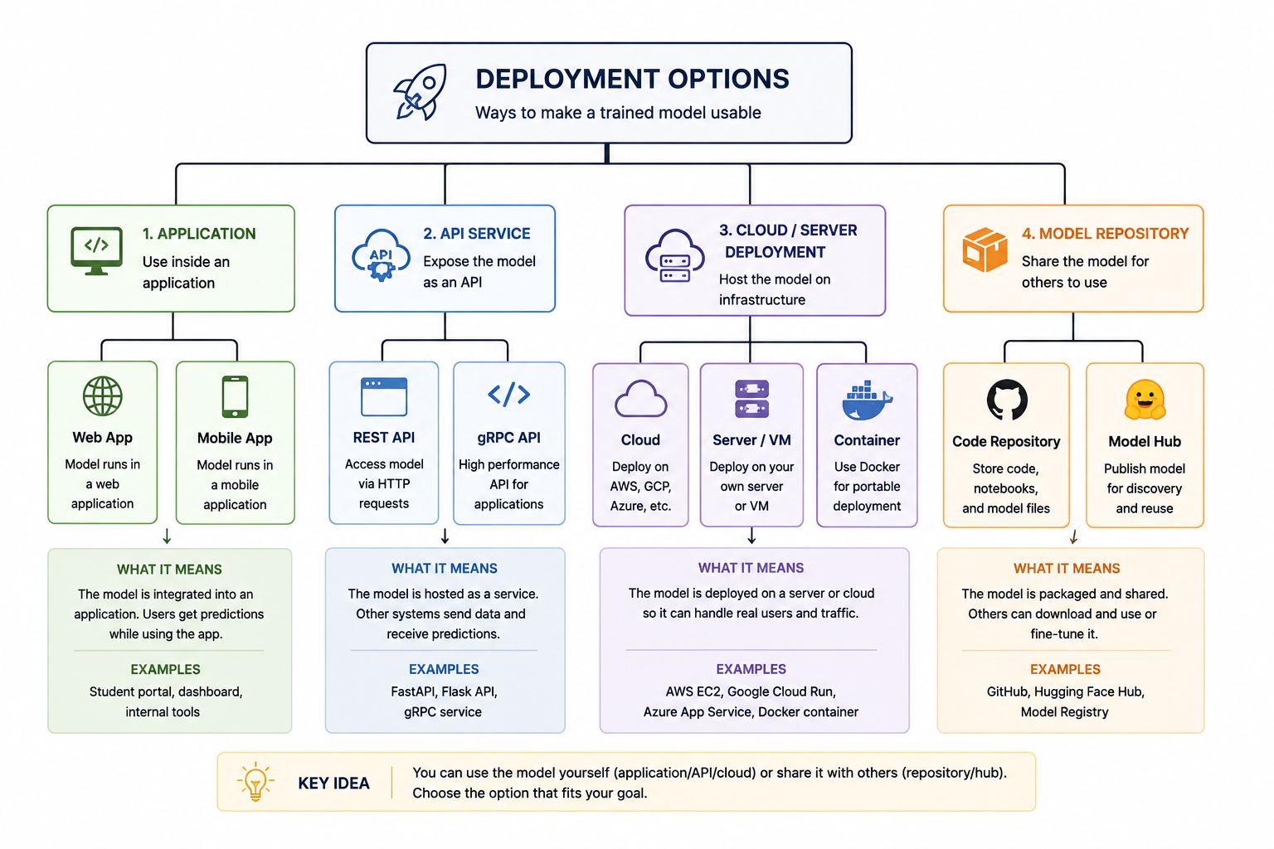
BILE Initiative · AI & Machine Learning Track
DAY 04
Deployment
Deployment Options
AI & Machine Learning Track

Slide 10
BILE Initiative · AI & Machine Learning Track
DAY 04
API FLOW
API prediction flow
Student Input
FastAPI
Saved Model
JSON Response
The API receives student data, runs the saved pipeline and returns a clear prediction result.
AI & Machine Learning Track

Slide 11
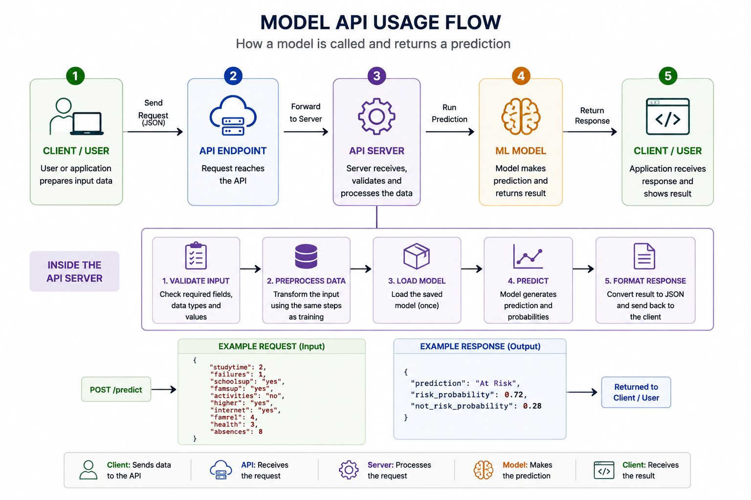
BILE Initiative · AI & Machine Learning Track
DAY 04
Model usage
Model inference workflow
AI & Machine Learning Track

Slide 12
BILE Initiative · AI & Machine Learning Track
DAY 04
API
Example API input and output
Part | Fields / values | Purpose | Notes
Request | 10 student features | Send data to the API | Must match training features
Prediction | At Risk / Not At Risk | Main classification result | Easy for users to read
Probability | 0.0 to 1.0 | Show model confidence | Useful for interpretation
Service info | root and health endpoints | Operational checks | Helpful for testing
AI & Machine Learning Track

Slide 13
BILE Initiative · AI & Machine Learning Track
DAY 04
PRACTICAL
Practical outcome for today
The baseline model is no longer just a notebook result.
1
Understand
We can save it, load it and use it for new student records.
2
Inspect
A simple API makes the model accessible to later UI or application work.
3
Prepare
This completes the core machine learning workflow from data to prediction.
4
Use
AI & Machine Learning Track

Slide 14
BILE Initiative · AI & Machine Learning Track
DAY 04
conclusion
conclusion
Key Takeaways
We turned the trained baseline model into a reusable prediction service.
The saved pipeline keeps preprocessing and inference together.
A FastAPI endpoint exposes the prediction cleanly for later integration.
The project now covers the full path: data, model, evaluation and prediction.
AI & Machine Learning Track

